Slide 1
Development Economics
ECON 4915
Lecture 13
Andreas Kotsadam

Slide 2
Outline
Recap on institutions and the slave trade.
Country level and local level institutions (Michalopoulos and Papaioannou 2011).
Questions from you.
Recap, recap, and recap.

Slide 3
Institutions and development recap
Acemoglu et al. (2001) argue that national level institutions are key for long term development.
They test the idea by using potential settler mortality as an instrument.

Slide 4
Identification Strategy and argument
Settlements
(potential) settler mortality
Early institutions
Current institutions
Current economic performance
Notes:
Ella

Slide 5
Glaeser et al. 2004
Offer a forceful critique on several fronts.
They argue that the measures of institutions are bad.
And they argue that the instrument used in Acemoglu et al. is bad (settler mortality is not correlated with objective measures of institutions and the instrument is not valid).

Slide 6
Critique from Glaeser et al
Settlements
(potential) settler mortality
Early institutions
Current institutions
Current economic performance
Human capital
Notes:
Ella

Slide 7
Nunn and Wantchekon (2009)
Historical events may be propagated by changed culture.
Example of the effects of the slave trade.
In fact, Nunn argues in another paper (2012) that the results in Glaeser er al. and Acemoglu et al. can be understood via culture:
”Rather than being two competing explanations for long-term growth, they are both part of the same evolutionary process. The confusion arises from the fact that neither paper acknowledges the role culture plays in shaping domestic institutions.”

Slide 8
Michalopoulos and Papaioannou 2011
Research question: Do institutions matter and which ones?
    Interesting? Yes, THE QUESTION in development.
    Original? Yes, using nighttime light and detailed geographic information allows them to ask new questions.
    Feasible? Yes, by collecting innovative data and using RD.

Slide 9
Main argument
While many argue that national institutions are key, they downplay the role of pre-colonial ethnic-specific institutions.
These local institutions are particularly important in developing countries precisely because of limited state capacity.

Slide 10
Two questions
Do current nationwide institutions affect economic performance across regions once we account for ethnicity-specific traits, culture, and geography?
Do pre-colonial institutional ethnic characteristics correlate with regional development once we consider country-specific attributes?

Slide 11
Innovations
Use a map portraying the spatial distribution of ethnicities.
Combine with data on the economy, institutions, and cultural traits of ethnic groups around colonization.
Measure regional economic development at the ethnicity-country level using satellite images of light density at night which are available at a fine level of aggregation.

Slide 12
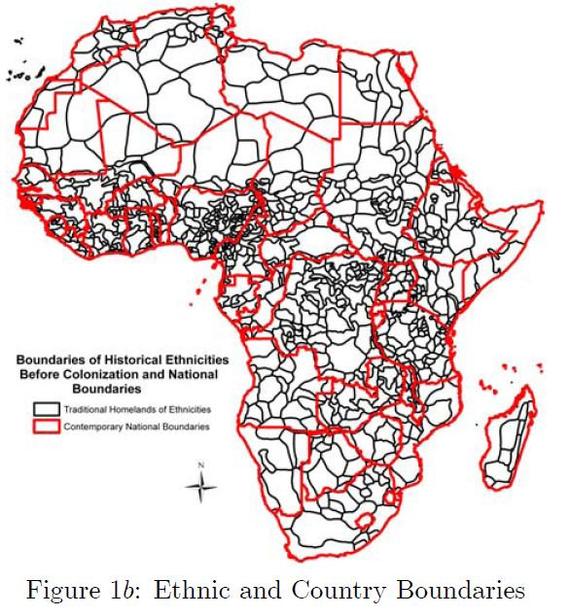

Slide 13
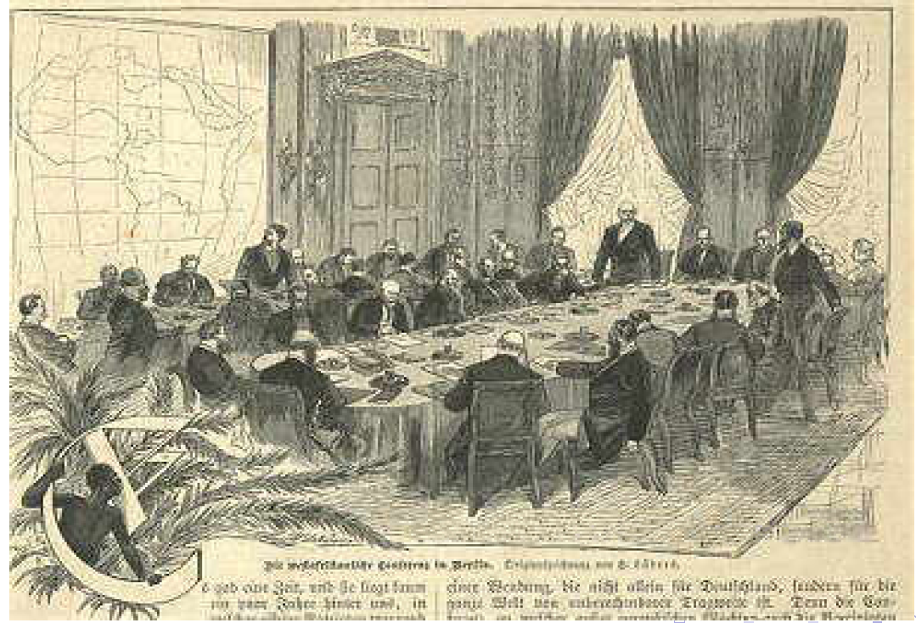
The borders of Africa were drawn by these idiots at the Berlin Conference

Slide 14
Arguments for using the borders as an experiment
At the time of drawing the borders, the colonizers had not even explored most of Africa.
No ethnicity-specific measures can predict which ethnicities became partitioned.
There has been very few changes in borders since independence.
Compare economic performance in regions belonging to the historical homeland of the same ethnic group, but subject to different contemporary national institutions.

Slide 15
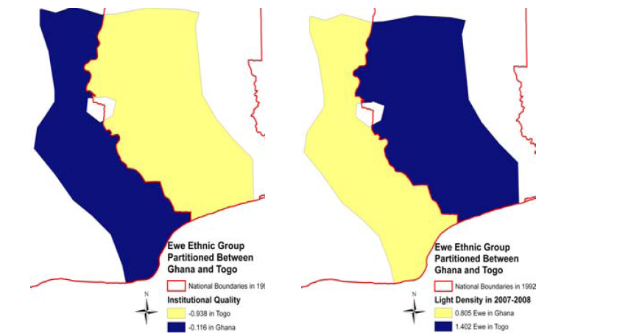
Same ethnic group in different countries.

Slide 16
Satellite light density at night
The study requires detailed data on economic development at the local level.
In addition there are problems even with cross national data, e.g. GDP (measurement; unavailability; shadow economy).
Satellite Light Density: available at every sq. km.
Strongly correlated with income and public goods provision.

Slide 17
Examples of what the data can tell us
If you find this interesting, see Henderson et al. (2012) ”Measuring Economic growth from outer space”.
Opens up a wide array of possible questions.

Slide 18
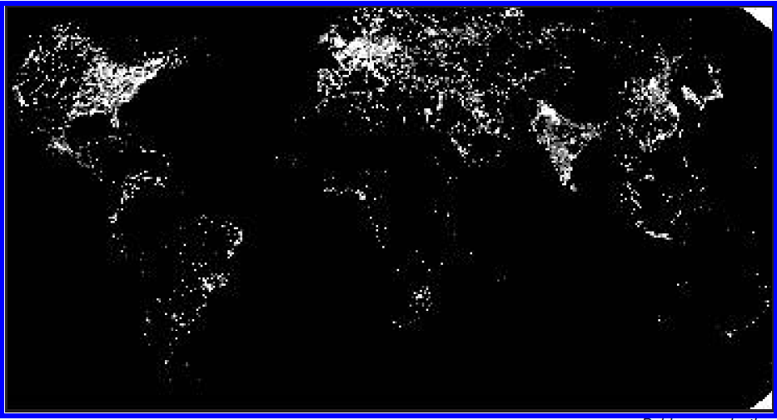
Global view

Slide 19
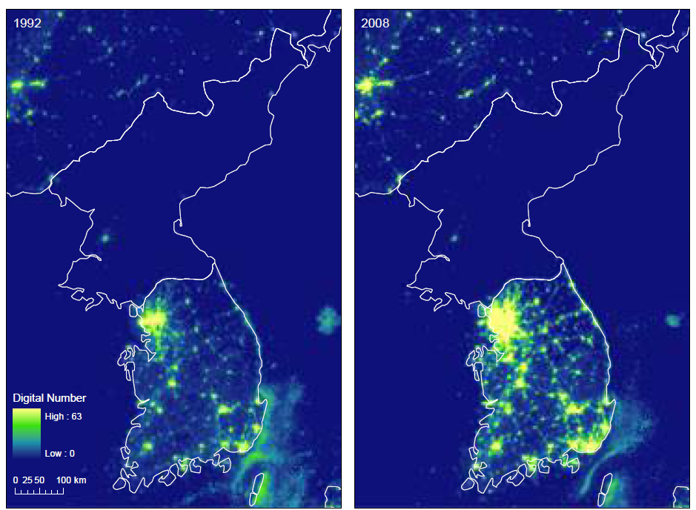
Growth on the Korean peninsula

Slide 20
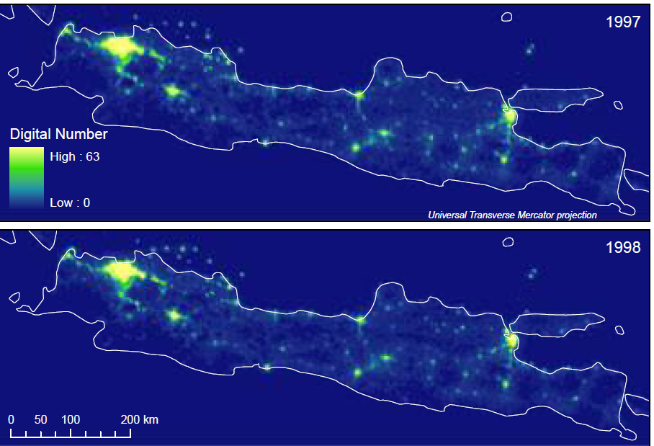
Effects of the Asian financial crisis

Slide 21
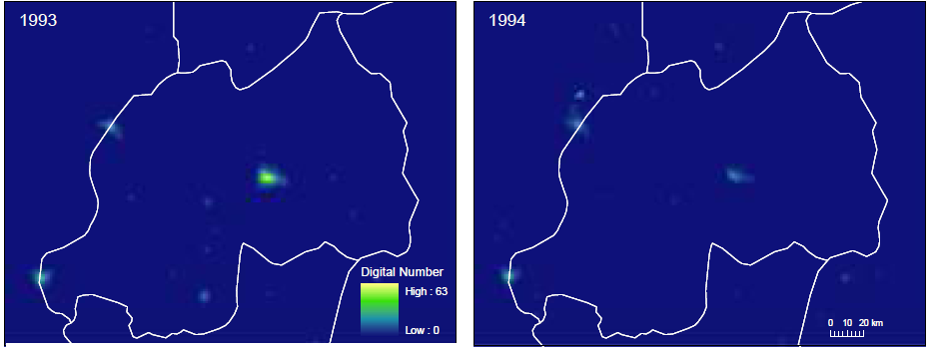

Effects of the Rwandan genocide

Slide 22
More data stuff
They use the Ethnographic Atlas (Murdock 1967) which includes variables such as crop use, marriage patterns, local institutions etc. at the ethnicity level before colonialization.
Focus on the variable: Jurisdictional Hierarchy above the Local Community Level

Slide 23
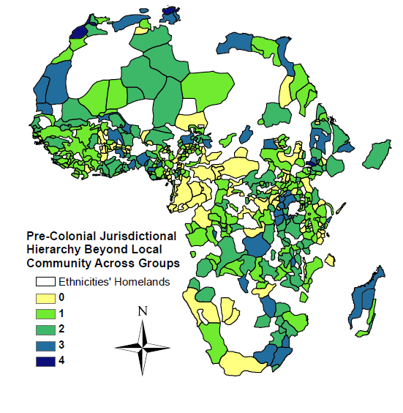

Slide 24
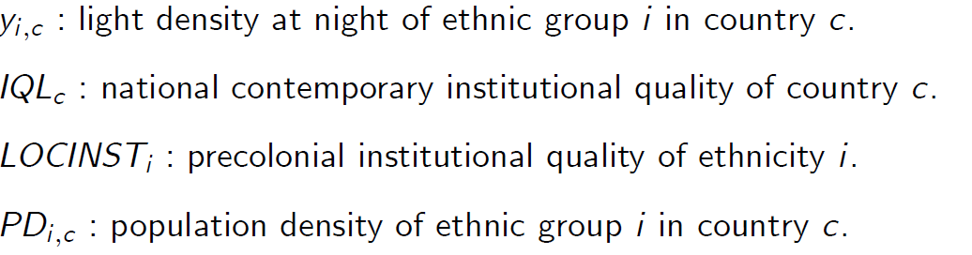
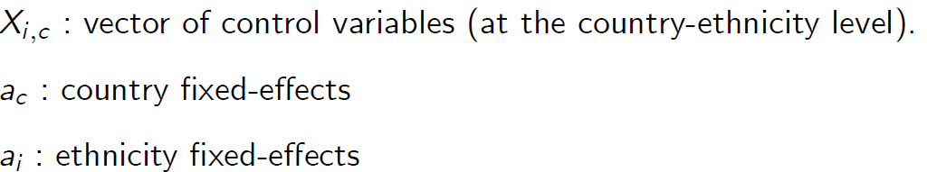
Empirical specification

Slide 25
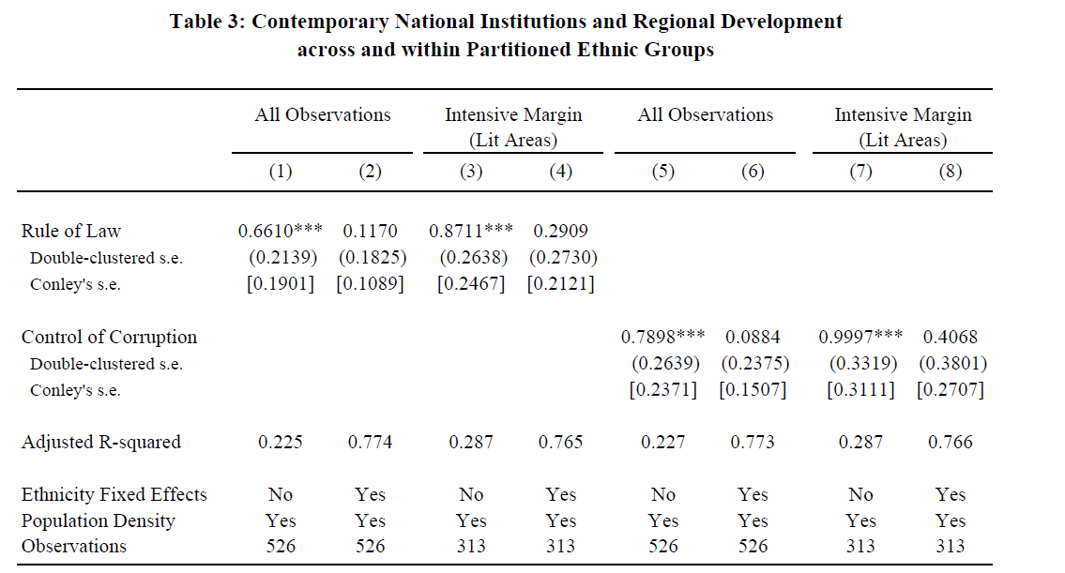

Slide 26
They also exploit the borders
They use the fact that the changes in the quality of national institutions jumps discontinuously at the border.
Across the borders, geography, natural resources, diseases etc. is equal but national institutions are not.
They check that the results are not driven by migration.

Slide 27
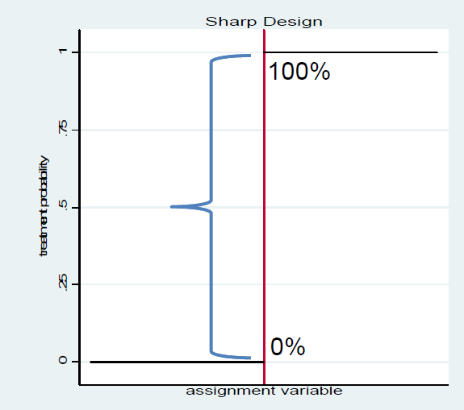
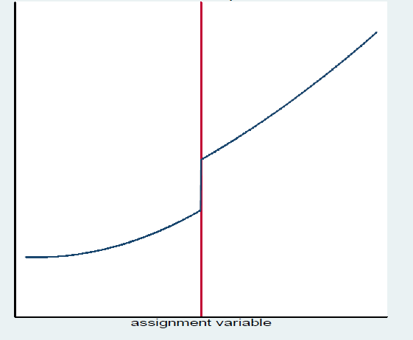
Recap Regression Discontinuity

Slide 28
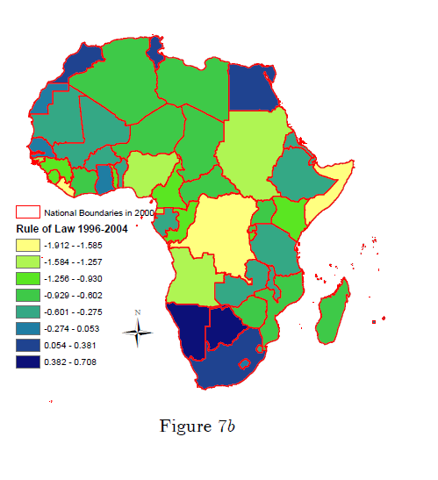

Slide 29
”The underlying idea is that by comparing regional development in the historical homeland of the same ethnicity exactly at the border, where only the quality of national institutions differs, one accounts for all characteristics that may affect regional development.”
Again, they find no indication of more development in areas with better national institutions.

Slide 30
Summary so far
“The analysis uncovers that differences in economic performance within ethnic groups partitioned across different countries cannot be explained by countrywide differences in institutional quality. While this result does not necessarily generalize to areas far from the national borders or other parts of the world, it casts doubt on the causal interpretation of the cross-country positive correlation between institutional quality and economic development in Africa.”

Slide 31
What about the pre-colonial institutions?
They find a robust correlation between ethnic pre-colonial institutions (political centralization) and contemporary regional development.
“Since we do not have random assignment on ethnic institutions, this correlation does not necessarily imply causation.”
But it is robust to control for geography at a fine level, country characteristics, and other ethnic traits.

Slide 32
Recap, questions from you, and exam questions

Slide 33
Questions from you
Credit rationing: Why is there credit rationing? Why is it worse to borrow out for consumption?
How does the instrument work in the article "Does rural bank matters?"?
What should we focus on (for the exam) when reading?

Slide 34
Look at your notes from lecture 2, slide 7:
Credit rationing:
    What is it?
    Why does it occur, in particular, why doesn’t the lender just raise the interest to lend out more?
    Explain intuitively how information asymmetries may cause credit rationing.

Slide 35
Empirical strategy in Burgess and Pande (2005)
Use the imposition and removal of the 1:4 branch licensing policy, as instruments.
Relevance: The policy must be a predictor for the number of banks.
Validity: The policy should not affect rural poverty in other ways than via the number of rural banks.

Slide 36

Relevance
Does the reform predict the number of banks?

Slide 37
Figure 1

Slide 38
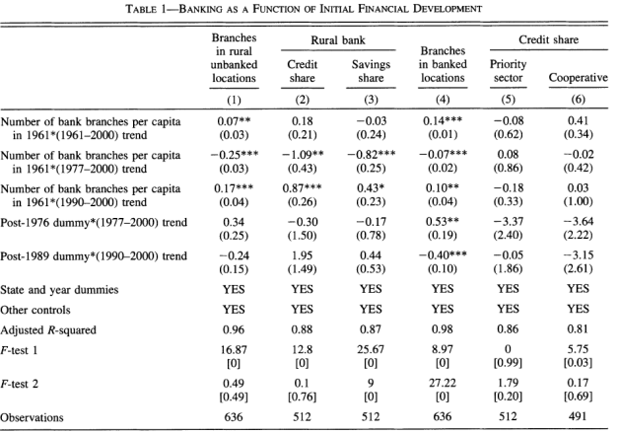
Note that they use the trend breaks as instruments.

Slide 39
Exam questions on empirical papers
The questions asked and the possible theoretical mechanisms.
The empirical strategies and internal validity.
The main results, mechanisms, and external validity.

Slide 40
Exam questions on book chapters and theoretical papers
Given all relevant information you should be able to reproduce simple models and graphs.
You should know the relevance of the models (i.e. what do they predict and do the predictions play out in real life, do they point to important mechanisms etc.?)

Slide 41
Exam questions on overview papers
These papers are often built up around questions and you should know the idea, arguments, and empirical evidence.
Examplels; Frankel (arguments and evidence for the resource curse), B&D (arguments and evidence for microfinance), O&P (arguments, measurement, and evidence for corruption) Duflo (arguments and evidence for the relation between development and gender equality).

Slide 42
Recap. Possible exam question
Duflo (2011) goes through the relationship between women’s empowerment and economic development. What are the possible arguments for the relationship. In particular, does development cause empowerment and does empowerment cause development?

Slide 43
    Does development cause empowerment?
Common arguments:
    Reduces discrimination.
    Frees up women’s time.
    Changes expectations.
    Technological changes (maternal health, washing machines etc.).

Slide 44
Discrimination under extreme circumstances
Girls are treated differently when ill, e.g. more than twice as likely to die of diarrhea in India.
The excessive mortality rate of girls, relative to boys, spikes during droughts.
When the harvest is bad, due to droughts or floods, and food is scarce, the murder of “witches” is twice as likely to occur as in normal years in rural Tanzania.

Slide 45
Policy implications
General interventions to reduce poverty may help women more.
Access to health services (health insurance or free medical care).
Weather insurance and credit.

Slide 46
Summary of general development
Economic development reduces inequality by relaxing the constraints poor households face, thus reducing the frequency at which they are placed in the position to make life or death choices.
By reducing the vulnerability of poor households to risk, economic development, even without specifically targeting women, disproportionately improves their well-being.

Slide 47
Expanding women’s opportunities
Parents have lower aspirations for their daughters than for their sons due to women’s fewer opportunities.

Slide 48
But economic growth is not enough
Sex ratios in China worsened despite growth.
Women earn less than men in all countries.
Legal rights are still worse for women and does not seem to follow economic development.
Huge gender gap in political participation and power.

Slide 49
Other crucial aspects
Implicit biases (See Beaman et al).
Stereotype threats.
Attitudes toward risk and competition.
Informal care.
Rigid power structures.

Slide 50
    Does empowerment cause development?
Common arguments:
    Effects of female education.
    Effects of female decision making in the hh.
    Productivity effects in agriculture.
    Effects of female political leaders.

Slide 51
The effects of quotas
Beaman et al. 2009.
What do I want you to take with you from this long paper?
The question and the possible theoretical mechanisms.
The empirical strategies and internal validity.
The main results and external validity.

Slide 52
Should we expect quotas to change norms in women´s favor?
No, people may dislike quotas as voter choice becomes limited.
No, as quotas may violate gender norms about what women should do.
Yes, if it provides information to risk averse individuals.
Yes, if it changes perceptions about what men and women should do.

Slide 53
Empirical strategies
First of all they exploit random variation in quotas for female leaders in India.
Since 1993 1/3 of all councilor positions and 1/3 of all chiefs (pradhan) must be women.
These reservations were randomly allocated so identification is straightforward.

Slide 54
Empirical strategies
Using this random variation they investigate whether women are more likely to be elected in areas previously reserved for women.
Then they move on to investigate whether change in voter attitude is a mechanism using survey data.

Slide 55
Empirical strategies
Vignettes with recorded speeches are further used to get experimental variation in bias against women.
IATs were used to measure gender-occupation stereotypes as well as taste based discrimination.

Slide 56
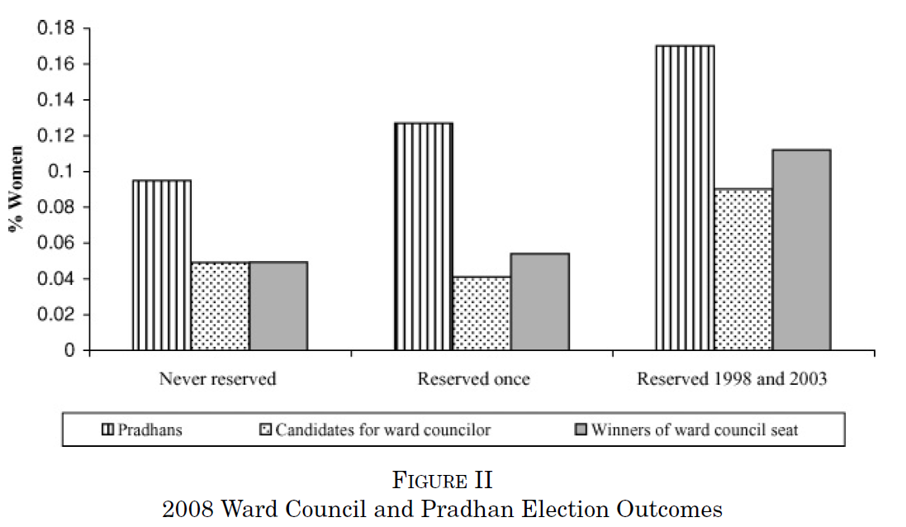
Reservation makes it easier for women to become elected in later years

Slide 57
Several mechanisms may be at play
First, female pradhans may act as important role models and mentors.
Second, female pradhans may have also helped create and strengthen political networks that benefit women politicians.
Third, women leaders take different policy decisions.
Fourth, exposure to a female pradhan may change voter attitudes.

Slide 58
Results
A significant bias among men in never-reserved villages in the vignettes and reservation reverses this bias.
Both genders associate leadership activities more strongly with men in never-reserved areas and quotas reduces this association among male respondents.
No effects on taste for female leaders

Slide 59
To conclude
Internal validity: Clear cut.
Mechanisms: Extremely nice with experiments on experiments.
External validity: Quotas need not produce the same results in other settings. And other types of quotas!

Slide 60
Qian
We have gone through this paper several times.
Again, I want you to know:
The question and the possible theoretical mechanisms.
The empirical strategies and internal validity.
The main results and external validity.

Slide 61
Jensen and Oster
Does cable tv improve the status of women?
Son preference: “Would you like your next child to be a boy, a girl, or it doesn’t matter?”
Domestic violence: A husband is justified in beating his wife if X, Y, Z.
Autonomy: Who decides on X, Y, Z? Need permission to X, Y?
Fertility: Currently pregnant, and birth histories.

Slide 62
Empirical strategy
”…relies on comparing changes in gender attitudes and behaviors between survey rounds across villages based on whether (and when) they added cable television” (p. 1059).
= Difference in differences (DD).

Slide 63
Recap DD
Typical DD assumption: ”villages that added cable would not otherwise have changed differently than those villages that did not add cable. ”

Slide 64
The typical DD problem
”… we cannot rule out with our data is that there is some important unobservable that simultaneously drives year-to-year cable introduction and year-to-year variation in our outcome measures. Although this seems unlikely, and we are unable to think of plausible examples, it is important to keep this caveat in mind.”

Slide 65
They are concerned about omitted variables
“A central empirical concern is the possibility that trends in other variables (e.g., income or “modernity”) affect both cable access and women’s status.” (p. 1059f).
First of all, they have to describe the factors determining which villages got cable.
Then they look closely at the timing of the effects, including testing for the effects of future cable.

Slide 66
Mechanisms
Why does it have an effect?
    Provides information on birth planning?
    Change the value of time?
    Men’s leisure time is higher?
    Or, their pick: Exposure of urban lifestyles
We don’t really know. More research is needed.

Slide 67
External validity and data issues
Main dataset includes only hh with oldies.
Men were not interviewed, would have helped for the mechanism discussion.

Slide 68
Error in the paper
On page 1077 they say son preference declines by 12 pp. It should say 8.8 as is evident in the table.

